Slide 1



Test Automation Framework Using QTP 9.5
NHS Automation Team

Slide 2
Road Map
Test Automation framework
Sequence for developing robust Test-automation framework utilizing Quick Test will be as follows:
  Define Test-Automation Architecture
  Define Add-ins
  Define Conventions
  Setup Action Appearance
  Create Object Repository Files
  Create Data Tables
  Setup Default Behavioral Events
  Setup Testing Options in the Script

Slide 3
Road Map (Contd…)
Test Automation framework
Develop Actions
Define Parameters
Develop External Library
Register User-Defined Methods
Define Recovery Scenarios
Call WR Scripts and User-Defined Functions
Automatically Submit Defects to Quality Center

Slide 4
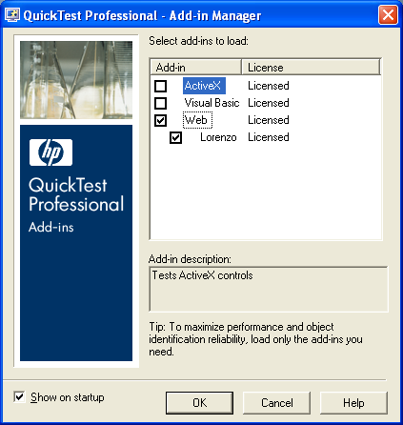
Define Add-ins
Test Automation framework
We need to know the development technologies of our AUT, and load the
Add-Ins prior to invoking QuickTest.

Slide 5
Define Conventions
Test Automation framework
Since QTP uses VBScript as a scripting language, we found best to
use Hungarian-like naming conventions (Microsoft VB naming
conventions).
Uniform code
Readability
Time and Resource savings during Maintenance

Slide 6
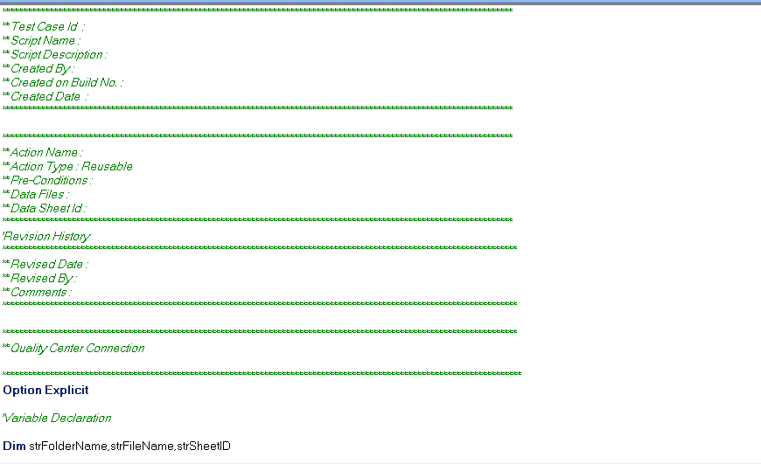
Setup Action Appearance
Test Automation framework
Customizing an Action by creating an Action Template.
In order to do this, we need to:
Create a text file with the desired text and QTP statements
Rename this file as ActionTemplate.mst
Save the ActionTemplate.mst file in <YourQTPDirectory>\dat directory

Slide 7
Create Object Repository Files
Test Automation framework
Two Types of Object repositories are available in QTP
Local Object Repository – The Local Repository associated with each Test by default.
Shared Object Repository – An Object Repository which can be used across several tests.
A Shared Object Repository is created using the Object Repository Manager tool or Export the Local repository using Object Repository tool and are associated with the test using Resources > Associate Repositories option.

Slide 8
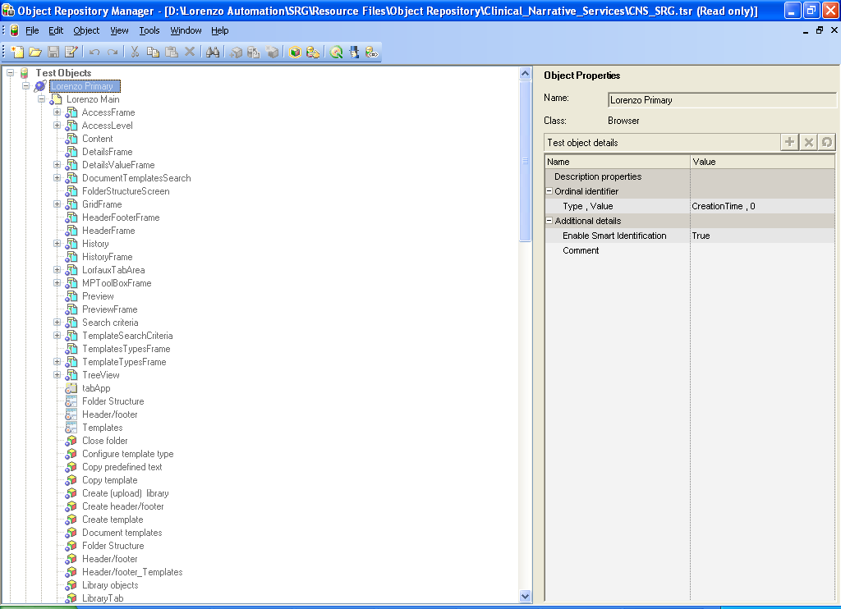
Create Object Repository Files (Contd…)
Test Automation framework
The Objects can be added to a shared Object Repository using
Object Repository Manager.

Slide 9
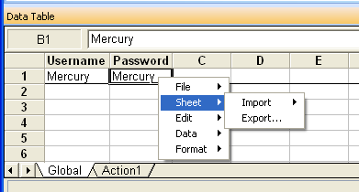
Create Data Tables
Test Automation framework
Global Data sheet – The Global Sheet of the DataTable which can be
used for all actions in the Test
Action Data sheet – The Data Sheet corresponding to each action in
the Test
External Excel sheet – An external Data sheet which can be either
imported to the QTP DataTable or accessed
directly using QTP.

Slide 10
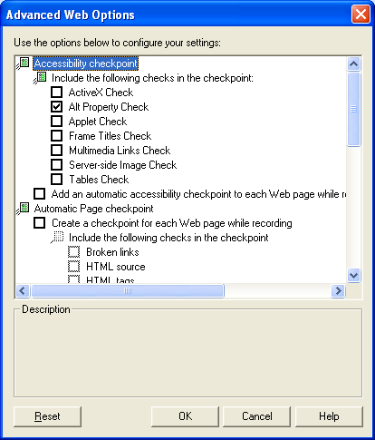
Setup Default Behavioral Events
Test Automation framework
Using these settings we may, for example
Set QTP to create Automatic Accessibility checkpoints per each web page, create global web page checkpoint during recording as you navigate to next page,
Perform browser clean-up as test exiting execution

Slide 11
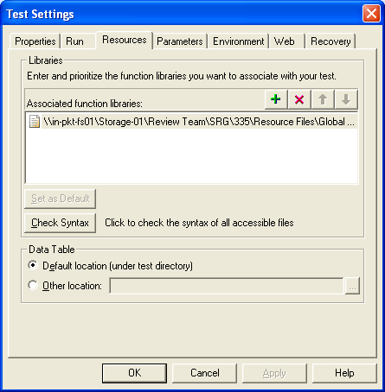
Setup Testing Options in the Script
Test Automation framework
Set up the Test Options for the Test
Run Options
The required Library files to be associated
Data Files
Recovery Scenarios to be associated

Slide 12
Develop Actions
Test Automation framework
QuickTest follows fully Event-Driven technology
There are two main types of Actions:
Regular Actions (Non-Reusable Actions)
Reusable Actions
    Internal (Reusable )Actions are Reusable Actions that are created and used in the given test on local scope.
    External (Reusable) Actions – Reusable Actions that were created in another test as Internal Actions and called by the given test.

Slide 13
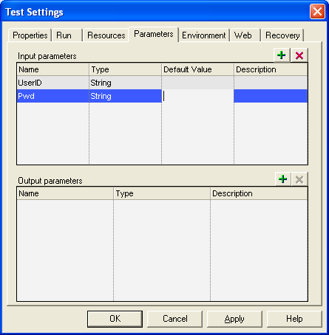
Define Parameters
Test Automation framework
Different methods of passing parameters
Environment Variables
Output Values
Input Parameters

Slide 14
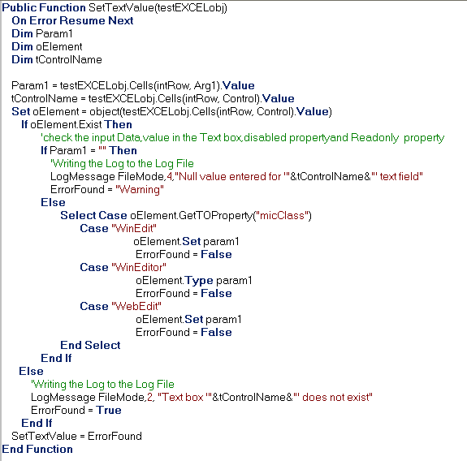
Develop External Library
Test Automation framework
Develop External Library with Reusable functions which can be used
across all tests.

Slide 15
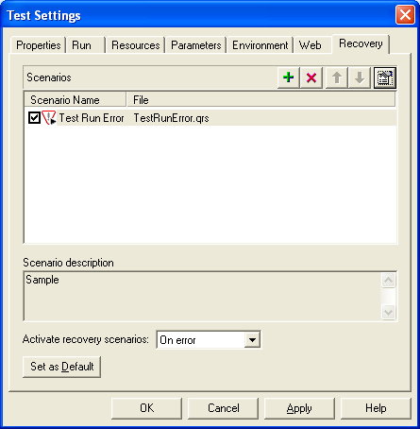
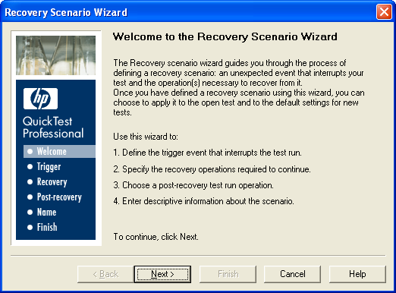
Define Recovery Scenarios
Test Automation framework
Create Necessary Recovery Scenario Files and associate with the Test.

Slide 16
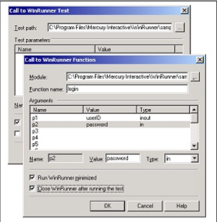
Call WR Scripts and User-Defined Functions
Test Automation framework
There will be situations when we need to use some of WinRunner scripts
developed earlier.

Slide 17
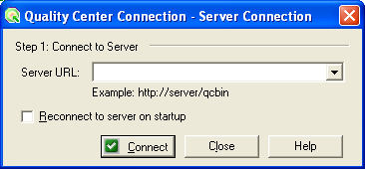
Script Execution from TD
Test Automation framework
Quality Center provides an intuitive and efficient method for scheduling
and running tests, collecting results, analyzing the results, and managing
test versions.
Enable the option by selecting Tools > Options > Run tab > Submit a
defect to Quality Center each failed step from the QTP tool bar

Slide 18
Summary of the Topics Covered
Working with Actions
Road Map for setting up a Framework
Define Add-ins
Define Conventions
Setup Action Appearance
Create Object Repository Files
Create Data Tables
Setup Default Behavioral Events
Setup Testing Options in the Script
Develop Actions
Define Parameters
Develop External Library
Define Recovery Scenarios
Call WR Scripts and User-Defined Functions
Script Execution from TD
Questions?

Slide 19

Thank You

